Slide 1
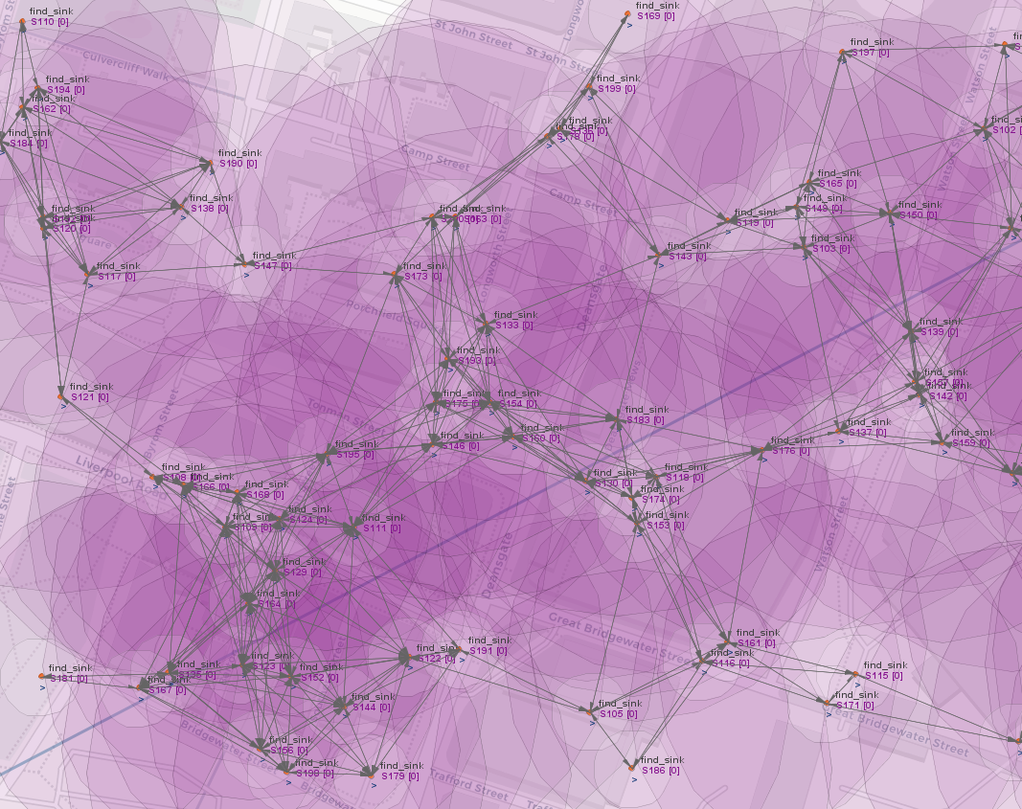
Multiple Sink Discovery
IoT Part 1 Final Project
Made by Ciro Ogliastro

Slide 2
The problem to solve
Given a dense WSN with at least 50 nodes, identify approximately 10 candidate nodes for sink roles.
Sink nodes must be located on the network's external perimeter and be evenly distributed geographically (more or less).

Slide 3
Approach to the Solution
How can we distinguish external perimeter nodes from internal ones?
My proposed solution is based on this observation: on average, perimeter nodes have less neighbors than internal nodes
Therefore, the problem becomes to identifying nodes with fewer neighbors than the average.
These nodes are likely to be on the network's external perimeter.

Slide 4
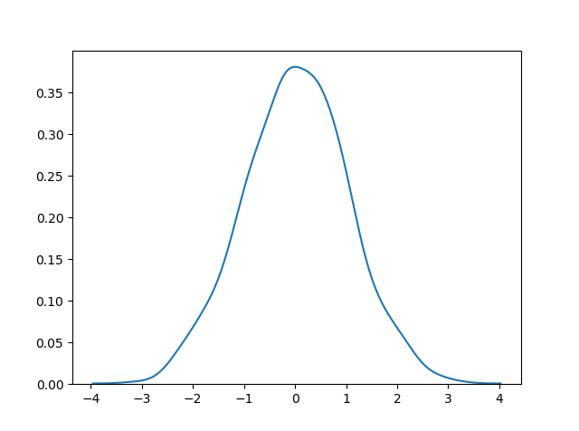
Reasoning on the solution
Nodes are randomly generated following a normal distribution, meaning their number of neighbors also follows a normal distribution.
I'm interested in nodes with neighbor counts falling on the left side of the distribution.
Therefore I considered only a portion of the average
All the nodes that have a number of neighbors less than this threshold are likely external perimeter nodes.
Computing the local average it's a good enough approximation

Slide 5
Parameters of the Algorithm: Sensitivity
The first parameter is called "sensitivity"
It's a tunable parameter between 0 and 1 that is multiplied by the local average of each node
Higher sensitivity (closer to 1) selects nodes nearer to the average (center of the Gaussian).
Lower sensitivity (closer to 0) selects nodes nearer to the lower tail of the distribution.

Slide 6
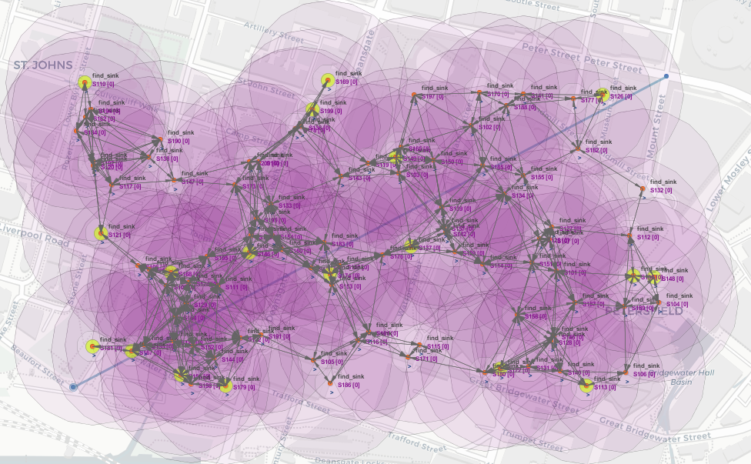
Simulation with Sensitivity=0.90 (Too High)
Too many nodes marked.
Internal nodes are marked

Slide 7
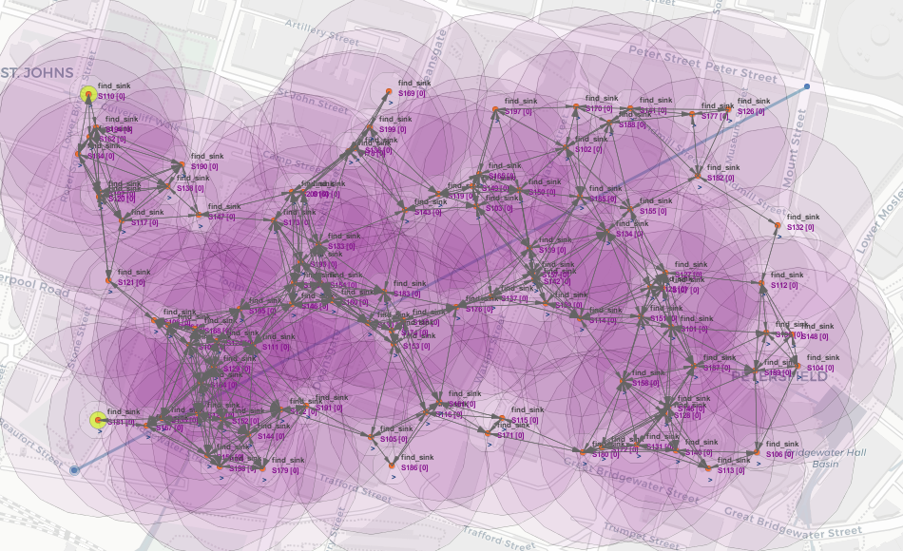
Simulation with Sensitivity=0.50 (Too Low)
Too few nodes marked (the goal is about 10 nodes)
Only external perimeter nodes are marked

Slide 8
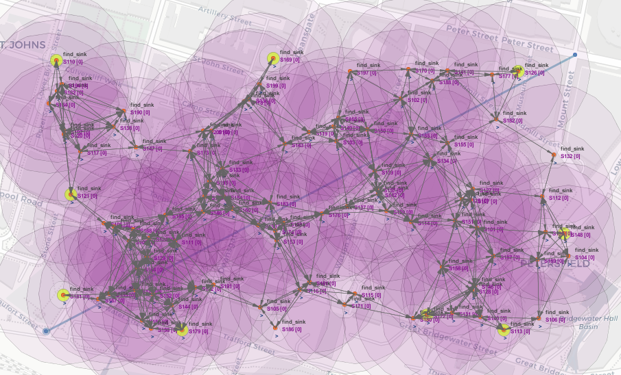
Simulation with Sensitivity=0.74 (Optimal)
After a few trial and error
9 marked nodes,
All marked nodes on the external perimeter

Slide 9
Parameters of the algorithm: RSSI
Sometimes, internal nodes may have fewer neighbors than average, causing the algorithm to mark them incorrectly.
To improve accuracy, the local average RSSI it is considered
An improvement is to consider the local average RSSI
The RSSI (Received Signal Strenght Indicator) measures the power level of a received wireless signal
It can help differentiate perimeter nodes from internal ones

Slide 10
Parameters of the algorithm: RSSI
Nodes on the perimeter in general have a similar local average RSSI
For more accuracy, I considered two thresholds: a minimum RSSI and maximum RSSI
A node is marked as a sink if (both are true):
It has fewer neighbors than the local average.
Its local average RSSI falls between the two thresholds.

Slide 11
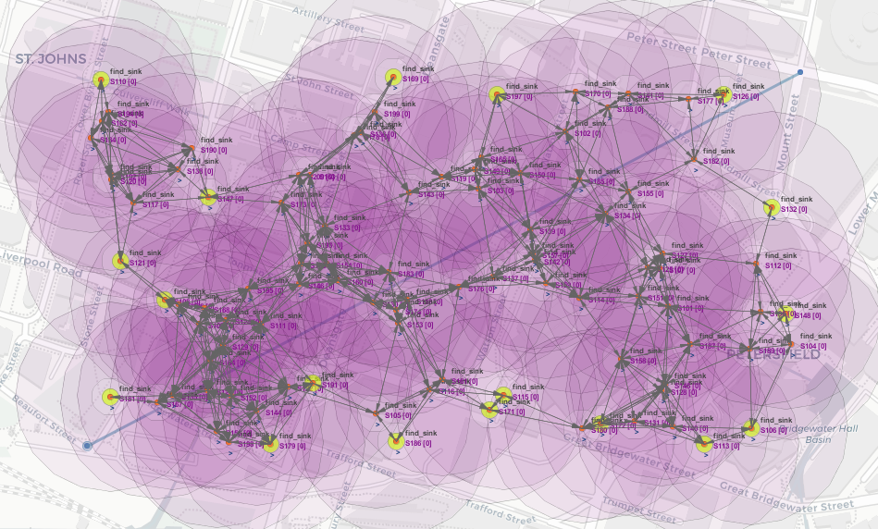
Simulation - no RSSI threshold
RSSI min=0
RSSI max =100
Sensitivity=0.74
18 marked nodes

Slide 12
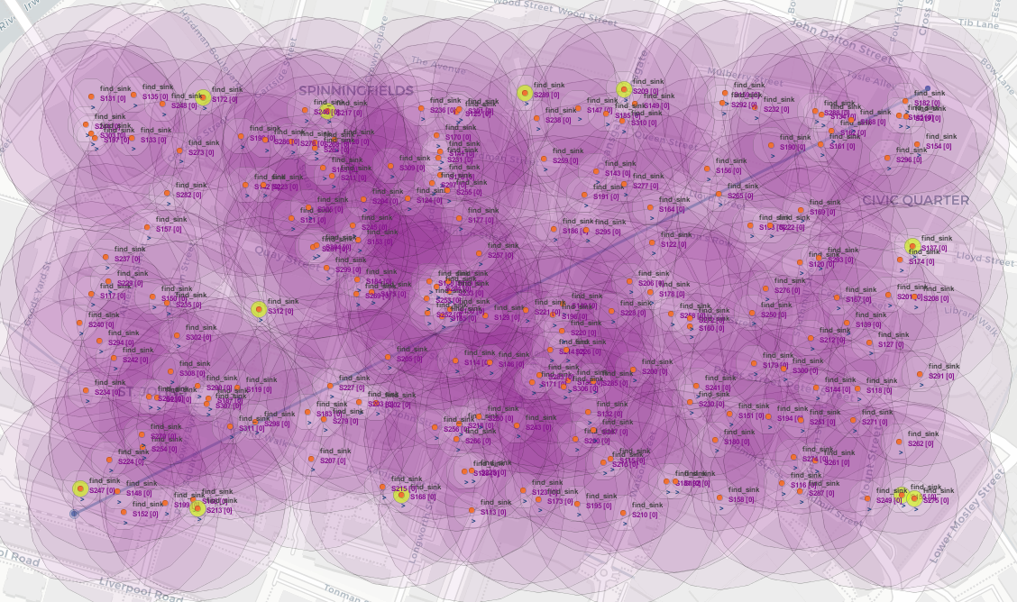
Simulation - Different Network with 200 Nodes
RSSI min = 0
RSSI max = 100
Sensitivity = 0.67
Notice that 1 internal node is incorrectly marked as sink

Slide 13
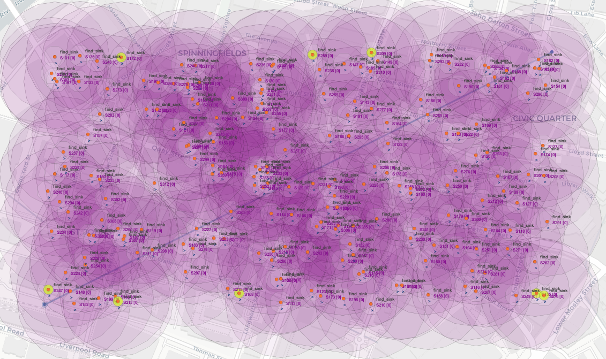
Simulation – Lowering maximum RSSI
RSSI min = 0
RSSI max = 65
Sensitivity=0.67
Internal node is no longer marked
But we lost some good perimeter nodes.

Slide 14
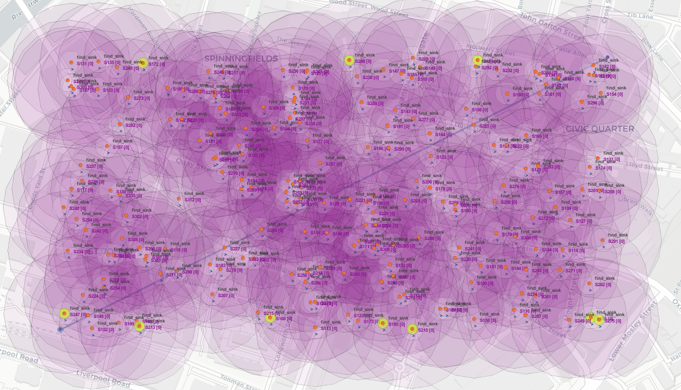
Simulation – Optimal Parameters
RSSI min = 45
RSSI max = 65
Sensitivity = 0.70
After tweaking the parameters, exactly 10 nodes were correctly marked.

Slide 15
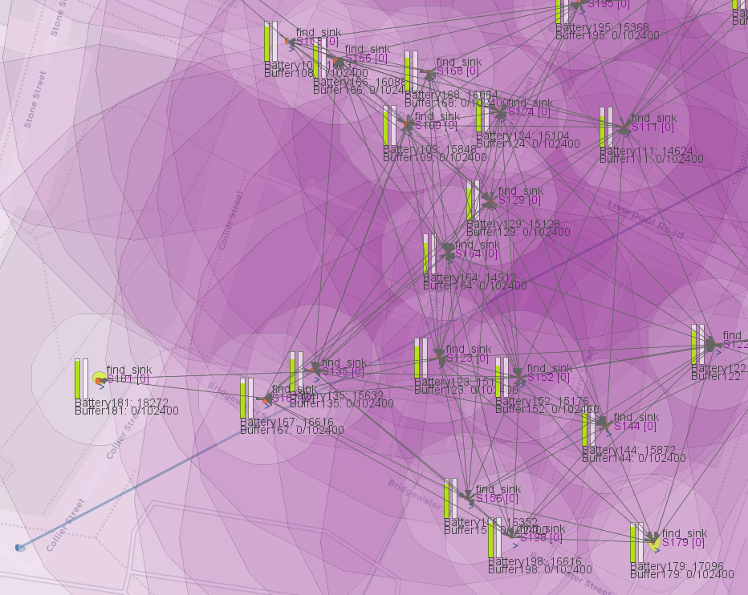
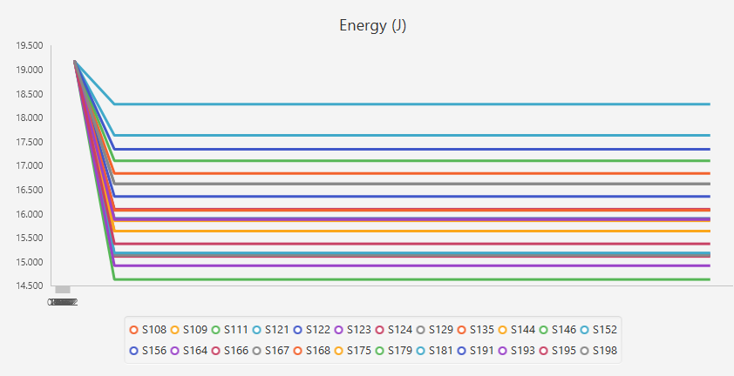
Energy Consumption & Network Lifetime
For energy consumption, I considered the following values E_TX=6, E_RX=3
The algorithm doesn't require much energy, nodes makes simple arithmetic operations, transmit one time and receive multiple times.
Internal nodes tend to consume more energy because they receive more packets.
Energy consumption grows as the number of nodes and number of connections grows.

Slide 16
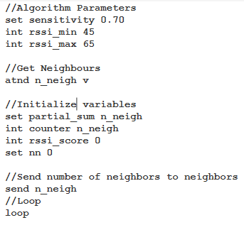
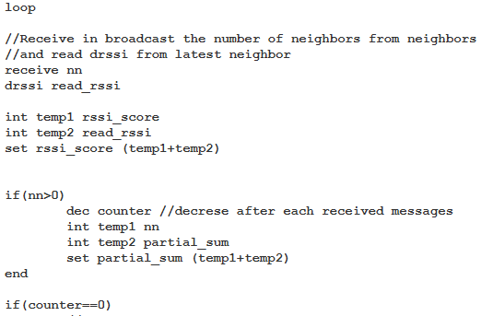
Comments to the SenScript Code

Slide 17
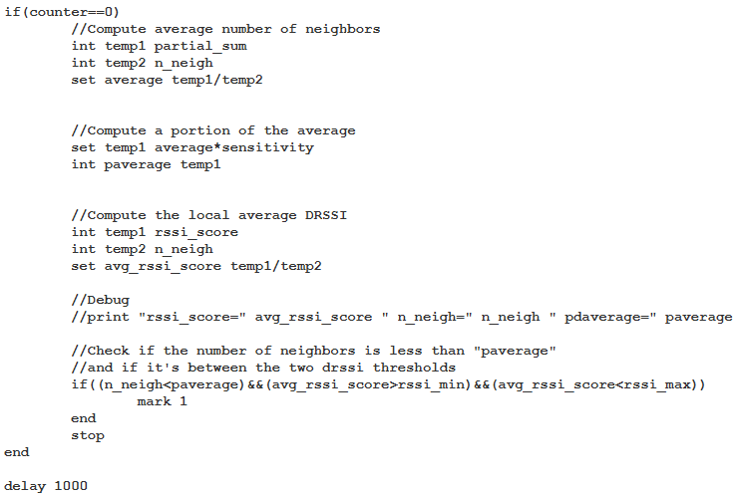
Comments to the SenScript Code

Slide 18
Pros and Cons of the solution
Pro
Cons
Energy efficient
Few data transmission
Very Fast
Works on every dense network
Cannot mark an exact number of nodes, depends on network topology.
Accuracy varies with network structure and parameter selection (Sensitivity & RSSI).
Isn't accurate on networks with fewer nodes

Slide 19

Possible Improvements
Considering battery levels as an additional factor
Internal nodes have more neighbors, receive more packets, and consume more energy.
The problem with this approach is that it would require more thresholds, making the algorithm more complex and requires more parameter tuning

Slide 20

Video Demo

Slide 21
Thank you for listening

